Slide 1

SUBJECT: Sales Force Management.
​
Case study no. 2​
Group Members: ​
Kamilla Mambetova / 44773​ Ayse Urs / 44378​ Ahmed Wedam Ahmed / 44509​
Murat Akar / 44771​
Mubunda Eliezer / 44503

Slide 2
Macro Factors That May Affect The Sales:
Lifestyle changes will continue to influence the demand for frozen pizzas. Working people and students have less time for themselves because of hectic lifestyles, so demand for fast food and frozen food has increased because it is convenient and fast.
Many people in the world lead busy lives and don’t have a lot of time to prepare food for themselves.
People save time and energy for more important things than cooking due to experiencing busier lifestyles and changing eating traditions in the world, the demand for instant and convenient food products has grown, which is foreseen to drive the increase in the frozen pizza market.
Moreover, the presence of cold chain logistics, the rise of innovative advertisement on social channels and the increased use of enhanced technology during production are key driving factors of the frozen pizza market.

Slide 3
Macro Factors That May Affect The Sales:
The UK population has become more health-conscious. Whether frozen pizzas are regarded as being healthy is debatable.
Although these convenience foods save time, it tend to have lower nutritional values and can be more expensive than food that takes more time to prepare. Fast food has always been associated with terms such as “unhealthy”, “fat-laden”, and “cholesterol booster”. Recently, these concepts are fallings away as a new trend of healthy fast food emerges, catching the fancy of millennials and Gen Z. Rising awareness about consuming healthy meals and promoting an environment-friendly lifestyle are factors prompting a change in consumer preferences.
As consumers become increasingly health-conscious, fast food brands are launching new products and drafting health-related communications strategies.The global fast food market is projected to grow from USD 972.74 billion in 2021 to USD 1,467.04 billion by 2028 at a CAGR of 6.05% during forecast period. The most powerful approach to dealing with criticism has proved to be the introduction of more health-friendly menu items.
For example, in pizza industry there are lots of ways to prepare it in healty way. There are lots of options to propose consumers new way of perception of pizzas. It can be "pizza gluten free" or "dough made from brocolli". It will diverse the menu and also it is not that expensive in cost to implement healty way of product.

Slide 4
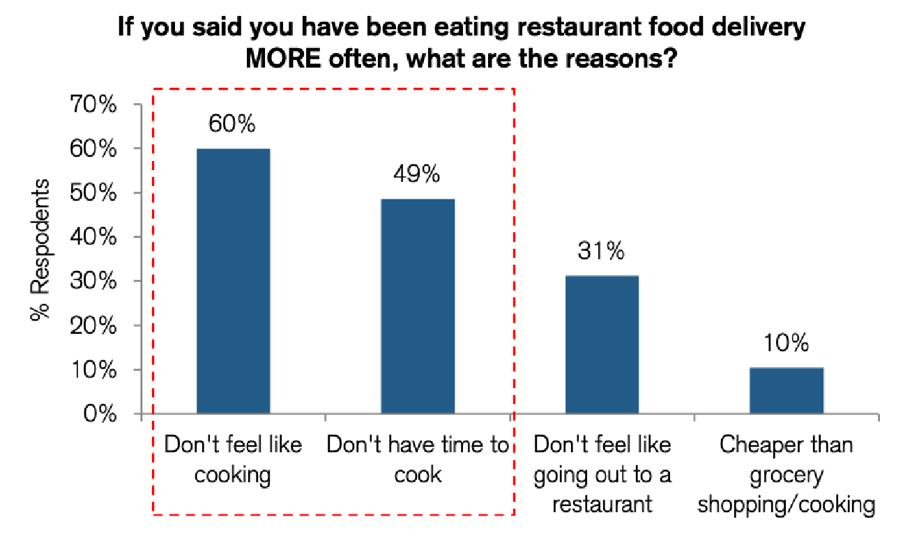
Numbers of working women and single-person households have increased, so this might have a positive effect on sales.
Here we also return to the topic of people wasting time and energy. Running a household alone is really hard. In order to cook at home, it is necessary to purchase products and allocate time every day to maintain the kitchen on an ongoing basis.
While consumers across all generations spend about 15% to 20% of their budgets on food, an increasing amount of that food budget is being spent on ready food, takeout, and delivery. This will lead to possitive trend in sales of pizzas in the market. As ready to eat meals are time saving and allow people to do more important things in running the houshold.

Slide 5
Longer working hours in the United Kingdom and changing eating patterns, meant that the convenience of frozen food is seen as being important.
Surely, we can state that frozen food is really convenient for office workers. In fact, people who incorporate frozen foods into their normal routine may have better diet quality.
During long hours in the office thare is no possibility to prepare something and not always people can have a lunch at the restuarant.
Frozen pizza is almost ready and can be heated in the kitchen of the office. Instead of the snack, full meal can be prepared.
This macro factor supposed to reveal a positive trend in sales of frozen pizzas in the market.

Slide 6
Strength
Strong Market Position
Diversification
Brand identity
Acquisiton
Family business
Logistic Advantages
Variety of products
Innovation
Customer loyality
Quality
SWOT analysis for Dr Oetkercompany

Slide 7
Weakness
SWOT Analysis Dr Oetker Company
Low flexibility, e.g. in the production process
Old fashioned image because of the established one
Opportunities
Different international Markets
Introduction of new products
Sustainability
Technological advances
Generic brands
Threats
Discounters
Fluctuant prices of raw materials
Generic brands
Regulation ( pestel)

Slide 8
Forecasting Method- Historical Review.
We can talk about a method called Historical Review. With this forecast method, we will use historical data to develop our own sales results.
This method is very straightforward and easy to perform, but it is only as accurate as the sales data you have available.
Dr. Outker can research the histories of similar new products (baking and dairy products) produced by rivals or other firms - this can serve as historical recommendations to assist build a new product sales projection.
There are a wide variety of forecasting methods available to sales managers. Historical review is widely used, and sales managers should review past sales performances and make adjustments for changing economic conditions.
Forecasting by time series projections entails projecting sales into the future by taking into account cyclical variations and seasonal trends in past years' sales data.
The best predictor of future behavior is past behavior. The first step in a historical review is to review the company’s sales for as many years as possible. This can be a simple bar chart or a more sophisticated chart showing trends in sales and comparisons of year to year performance. Then look at sales by each product category and identify what products have the greatest growth potential.
In other words, firms' levels of success in producing new products differ.
Finally, the origins of two new goods may appear to be the same at first glance, but they are controlled by completely distinct underlying reasons (for example trial results etc.…)

Slide 9
Forecasting method - Before-after retail simulation.
The before-after retail simulation method has many advantages over other forecasting methods, such as:
its simplicity;
it can be used for any type of business;
it can be applied to any period of time; it does not require much time or effort to implement; and it allows you to use actual figures instead of estimates.
When using before-after retail simulation, there are several key things to keep in mind:
The base period should be representative of your current situation.
It should include all relevant factors such as economic conditions and competition in the market.
Sales forecasting is the process of determining your projected turnover based on historical sales data. But that's not all! It also allows you to anticipate the number of units sold for a new product release, the number of clients you will keep in the future, or the subscriptions you will sell over a specific period, for example.
Here we suggest to the client to pick or buy the brands, as he can do of course or as he will be able to do throughout these following 15 purchases, we take into consideration the new product of Dr. Outker who is not in a rush of the simulation during this measure prior,
Finally, the customer gets introduced to a new product concept that is highly intriguing, or the PR and marketing of the new product circulate widely.

Slide 10
Forecasting method - Before-after retail simulation.
The consumer will then select whether to choose or buy initially.
Then we will have the shares of all market categories immediately before releasing a new product, as well as the same data just after introducing a new brand.
The new brand's market share is a measure of the brand's "instantaneous sales rate" at retail (or "current sales rate") at the conclusion of the first year, after subtracting predicted levels of brand recognition, trial, and distribution (and assuming that the product itself is at parity with major competitors).
However, first-year trial volume is largely removed from this sales prediction or inventory depletion, and the sales estimate is for the "current sales rate" at the end of the first year, not the first year.
It is therefore a more preferable forecasting approach, however it may be utilized alongside and contrasted to the historical review.

Slide 11
Product Relaunch- Dr. Oetker SuperCook Brand Products
Sales Budget
Products | Expected no of products sold |  |  |  |  |  | Total($)
 | Q1 | Q2 | Q3 | Q4 | Year | Unit Price($)
Pizza | 1200 | 1200 | 1200 | 1200 | 4800 | 5.00 | 24,000.00
Yoghurt | 600 | 600 | 600 | 600 | 2400 | 2.00 | 4,800.00
Desserts | 600 | 600 | 600 | 600 | 2400 | 3.00 | 7,200.00
Baking & Caking D.P | 1200 | 1200 | 1200 | 1200 | 4800 | 2.00 | 9,600.00
 |  |  |  |  |  |  | 45,600.00
Setting Target
For Pizza
1200/Q1(3 months)=400 per month
400/4 (weeks)= 100 per week
Notes:
First and foremost it provides a yardstick for which actual results can be measured against.
But if they had no target to aim for, how are you to know if the sales process and strategy you’ve implemented has been a success?
Setting goals
But from a distance this target may seem overly ambitious and impossible to achieve, demotivating the sales team and reducing their incentive to achieve it.
So in order to reach our target it will need to be broken down into smaller bitesize goals.
What’s more, research suggests that field sales reps that are able to track and visualize their sales goals are 20% more likely to improve their sales figures.
Increased efficiency
An effective sales budget process increases efficiency not just across the sales team, but also by reducing waste in manufacturing and operations.
In sales it allows field managers to assign specific goals to their team, that once achieved, will have a direct and positive impact on the overall sales targets. There’s no energy wasted on non sales-driving activities.
In order to know how much stock to manufacture, order and distribute across the different depots nationwide the different departments will need to know how much is expected to sell.
So if you overcook your sales budgets you’re going to be left with excess product which will be written off as waste. Equally, undercooking your estimations could leave you short of product with some very unhappy customers to boot.

Slide 12
Product Relaunch- Dr. Oetker SuperCook Brand Products
Sales Target
 | Pizza Weekly Sales Targets(100)
Sales Rep(Names) | Jan |  | Feb |  | Mar |  | Q1
Ahmed(464) | W1 | 75 | W1 |  | W1
 | W2 | 100 | W2 |  | W2
 | W3 | 89 | W3 |  | W3
 | W4 | 200 | W4 |  | W4
Murat | W1 |  | W1 |  | W1
 | W2 |  | W2 |  | W2
 | W3 |  | W3 |  | W3
 | W4 |  | W4 |  | W4
We need to meet the weekly targets.
Bonus given for Targets mets or exceeded the month
Notes:
First and foremost it provides a yardstick for which actual results can be measured against.
But if they had no target to aim for, how are you to know if the sales process and strategy you’ve implemented has been a success?
Setting goals
But from a distance this target may seem overly ambitious and impossible to achieve, demotivating the sales team and reducing their incentive to achieve it.
So in order to reach our target it will need to be broken down into smaller bitesize goals.
What’s more, research suggests that field sales reps that are able to track and visualize their sales goals are 20% more likely to improve their sales figures.
Increased efficiency
An effective sales budget process increases efficiency not just across the sales team, but also by reducing waste in manufacturing and operations.
In sales it allows field managers to assign specific goals to their team, that once achieved, will have a direct and positive impact on the overall sales targets. There’s no energy wasted on non sales-driving activities.
In order to know how much stock to manufacture, order and distribute across the different depots nationwide the different departments will need to know how much is expected to sell.
So if you overcook your sales budgets you’re going to be left with excess product which will be written off as waste. Equally, undercooking your estimations could leave you short of product with some very unhappy customers to boot.

